Slide 1
I want a motorcycle
and why my wife should let me get one

Slide 2
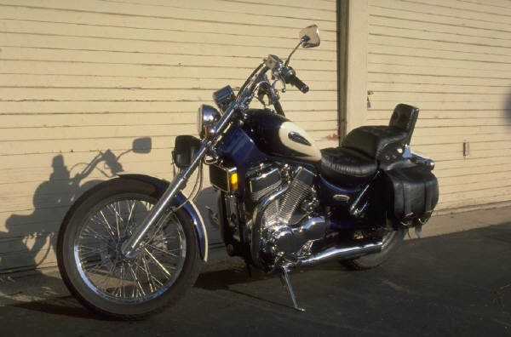
I really Want One
Top Align
Middle Align
Bottom Align

Slide 3

I promise to be safe
This runs First
Even when I’m going 100 MPH
Or Faster

Slide 4
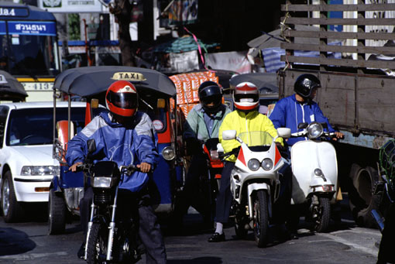
Motorcycles are Awesome

